Slide 1
Tourism Agency Database
Group: Rose, Tristan, Hyeon, Brian, Min Woo

Slide 2
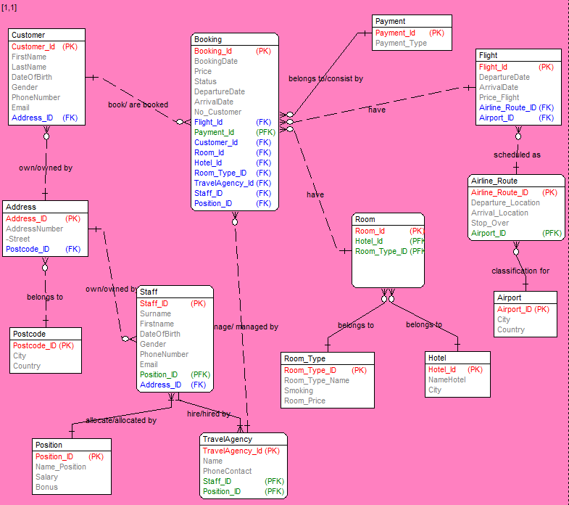
Database Model

Slide 3
Business Rules
Every payment may have many bookings
Many bookings must have one payment
Every address must have one postcode.
Each postcode may have many address
The customer must own one address.
Every address may have many customers
The staff must own one address.
Every address may be owned by many staffs
The agency may hire many staffs
Many staffs must be hired by one agency
Every staff must in charge of one position.
Every position may belong to many staffs.
Each customer may have many bookings
Each booking must be created by one and only one customer.
Each staff may manage may bookings.
Each booking must be managed by one staff.
Each flight may have many bookings.
Each booking must have only one flight.
Each room may have many bookings
Each booking must have one room.
Each flight must be scheduled by one airline route.
Each airline route may have many flights.
Each airline route must be defined by one airport.
Each airport may have many airline routes.
Each hotel may have many rooms
Each room must belong to one hotel.
Each room must have one room type.
Each room type may belong to many rooms

Slide 4
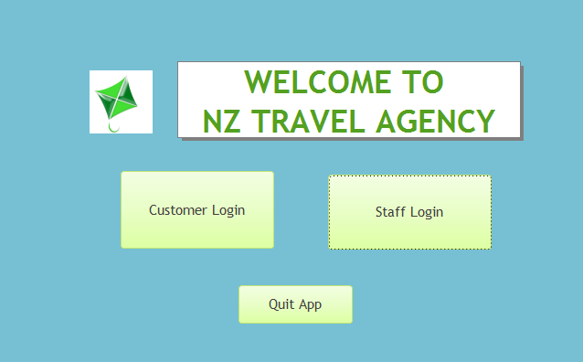
Main Menu

Slide 5
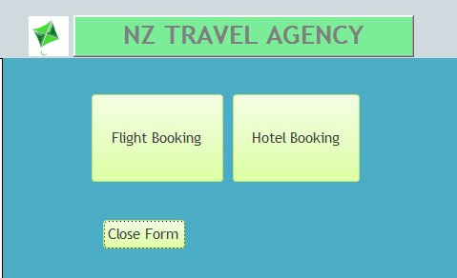
Customer login

Slide 6
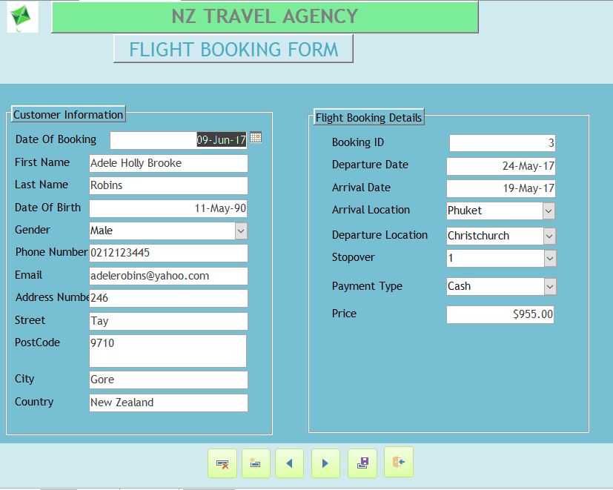
Flight Booking Form

Slide 7
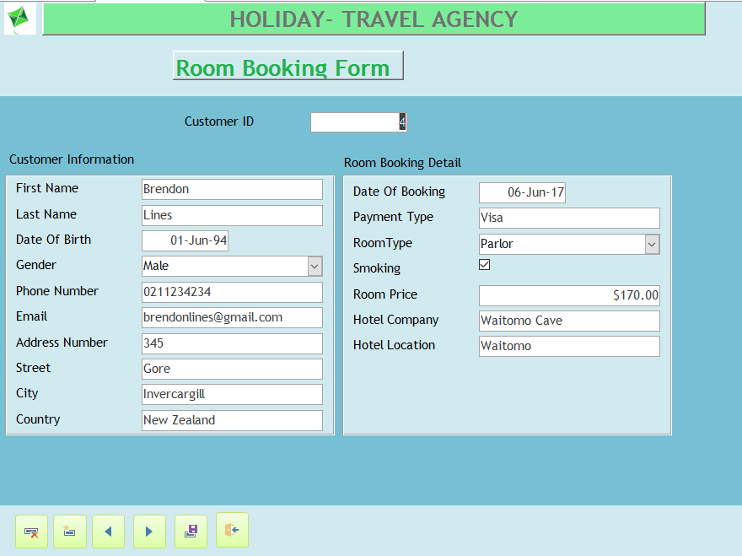
Room Booking Form

Slide 8
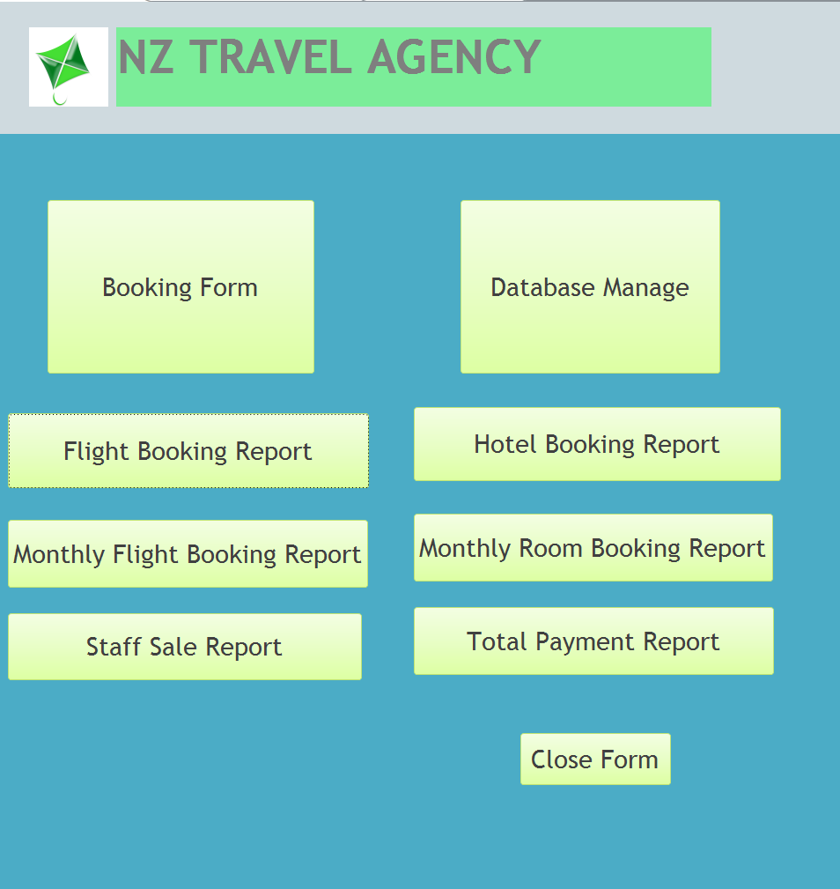
Staff Login

Slide 9
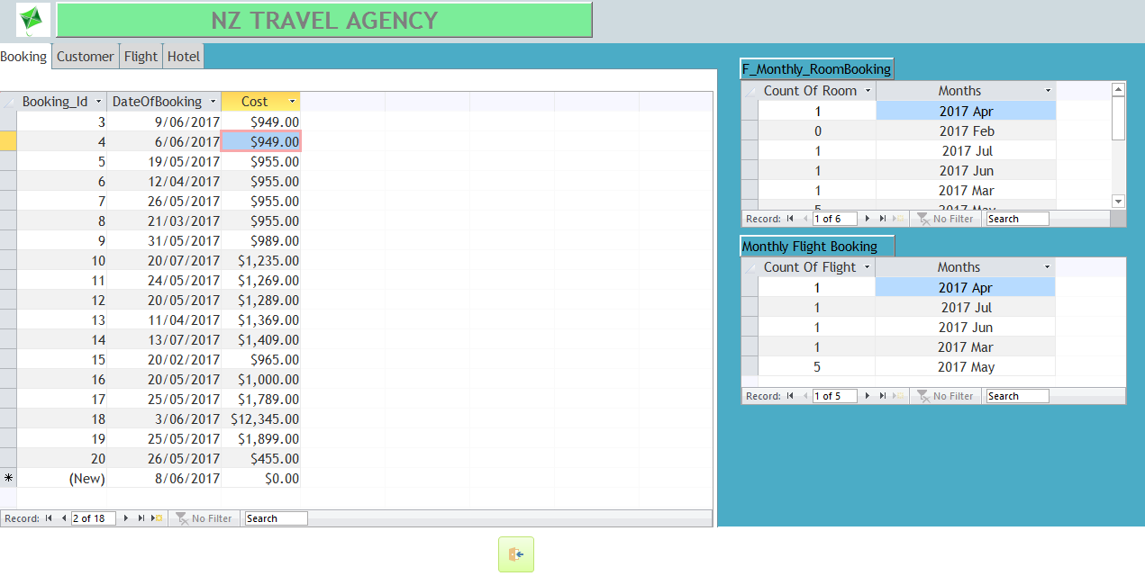
Database Form

Slide 10
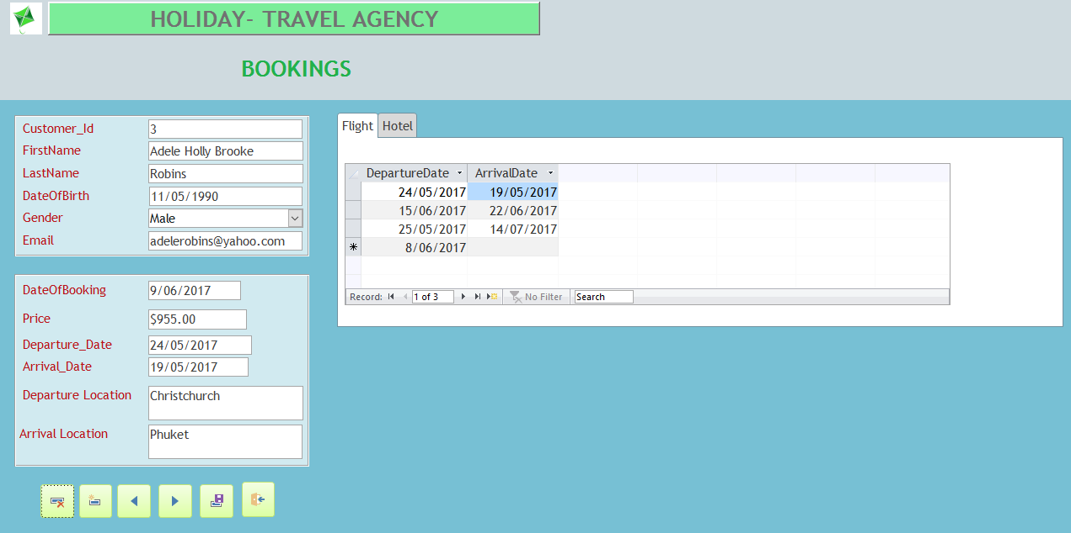
Bookings Form

Slide 11
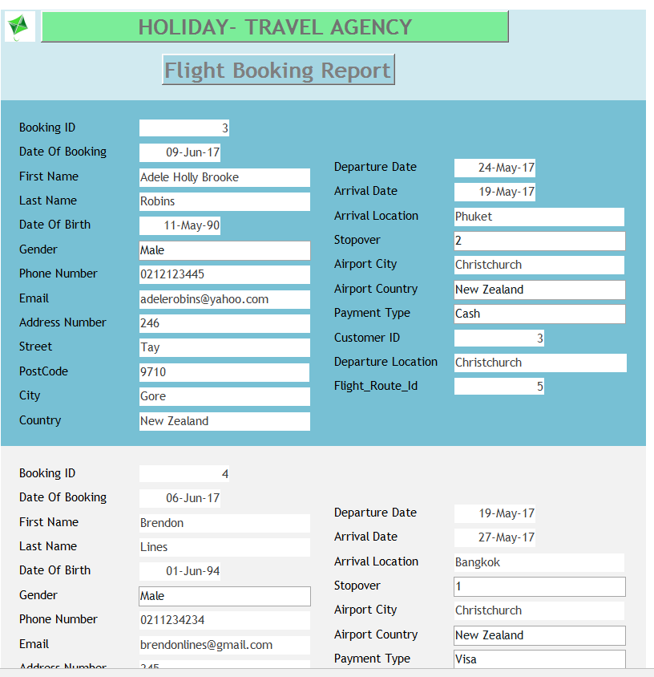
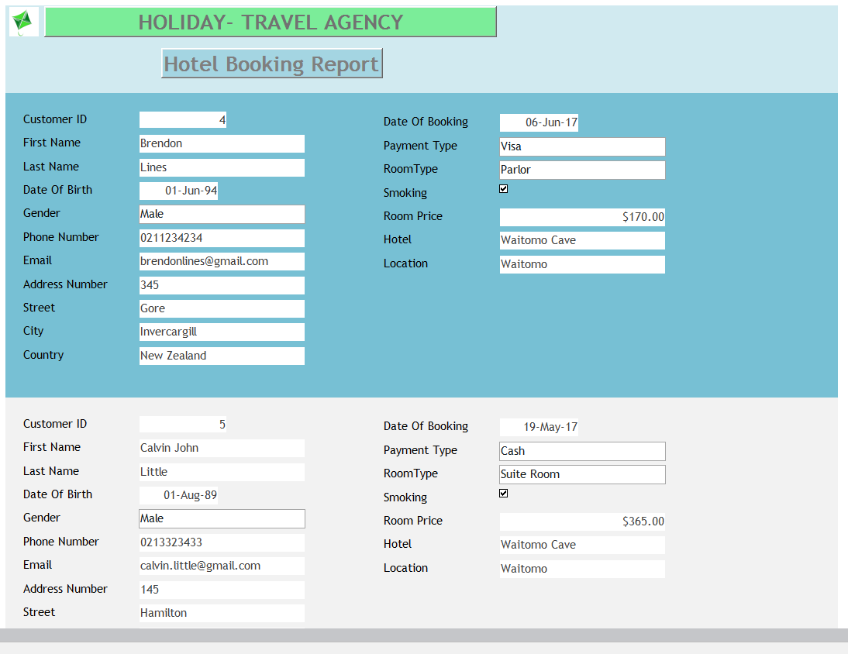
Reports

Slide 12
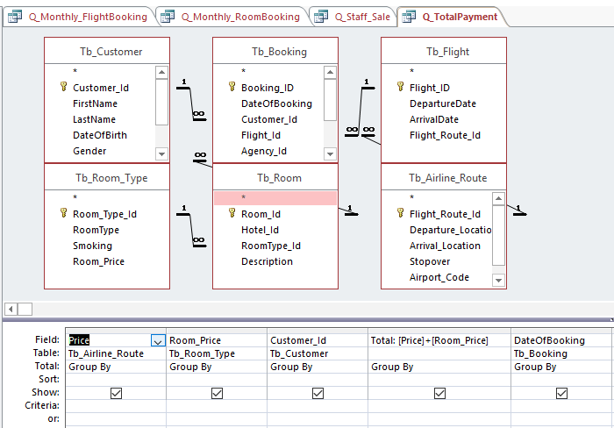
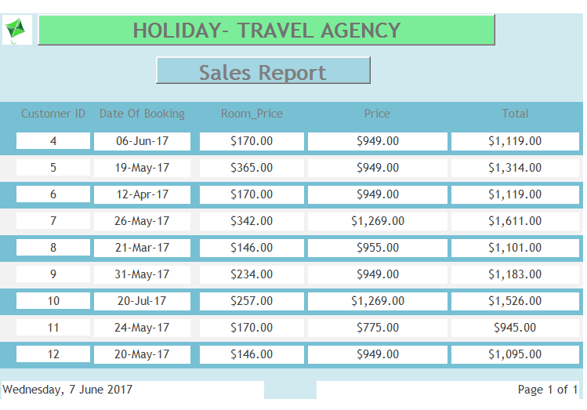
Sales Report

Slide 13
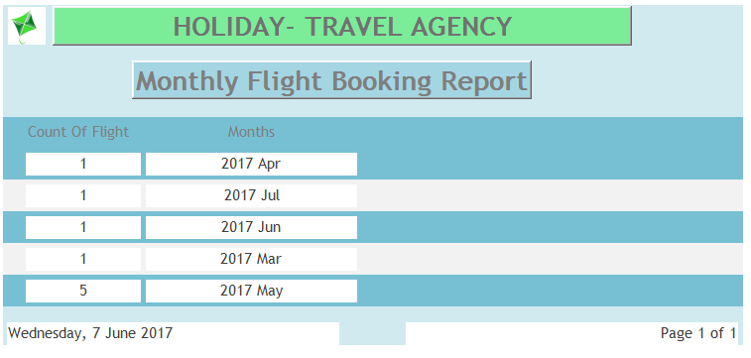
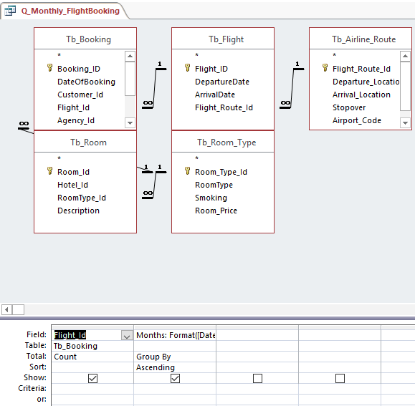
Monthly Flight Booking Report

Slide 14
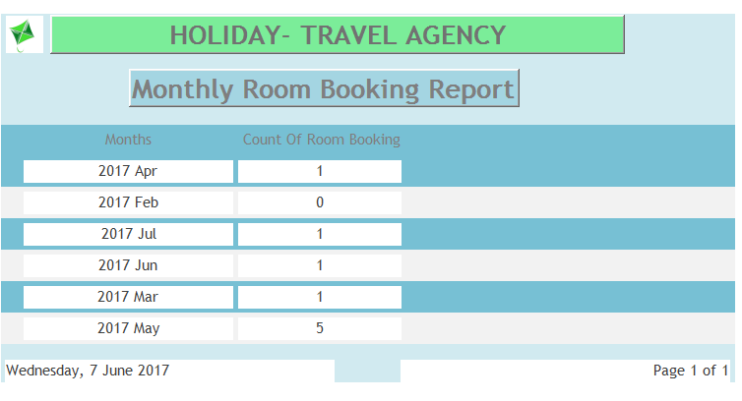
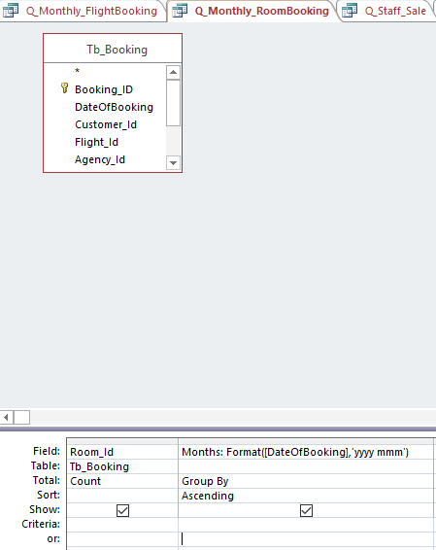
Monthly Room Booking Report

Slide 15
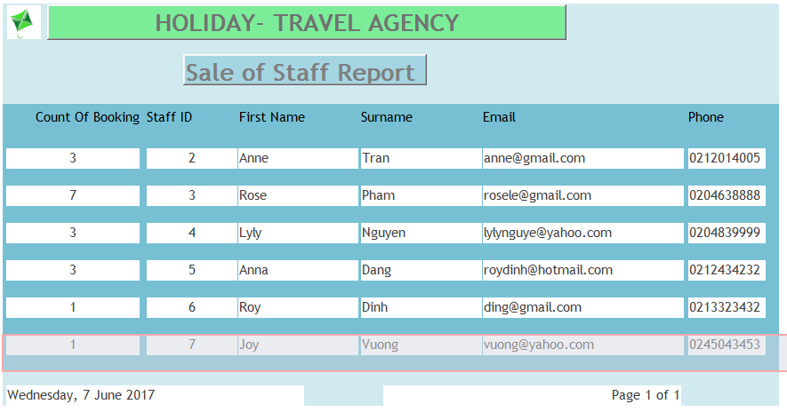
Sale of Staff Report

Slide 16
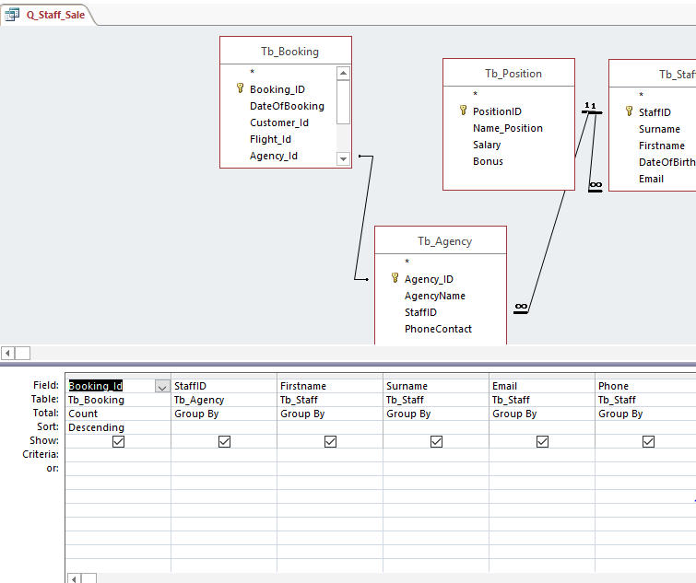
Sale of Staff Report

Slide 17
Usability Testing Results
Form/Report Name | Description of Component/ Interaction Problem & Solution
F_FlightBooking | Problem: Add new booking could not work, all field are empty. Solution: modified the queries
Main menu | Problem: the open form of customer did not work. Solution: Delete the open button and create a new one.
T_Customer | Problem: the phone number is hard to read Solution: change the format into 999-9999-999
Main menu | Problem: the open form of customer did not work. Solution: Delete the open button and create a new one.
T_Position | Problem: The currency field did not have $ symbol automatically. Solution: change the format into $###,##0.00
T_Position | Problem: The bonus field did not have % symbol automatically. Solution: change the format into ###.00%
Main menu | Problem: the reports could not open from the main menu form. Solution: add the button to open reports
F_Booking | Problem: the date of birth requires between 1 and 100 age. Solution: have to calculate the date, so we change the validate rule into > 01/01/2017

